Slide 1

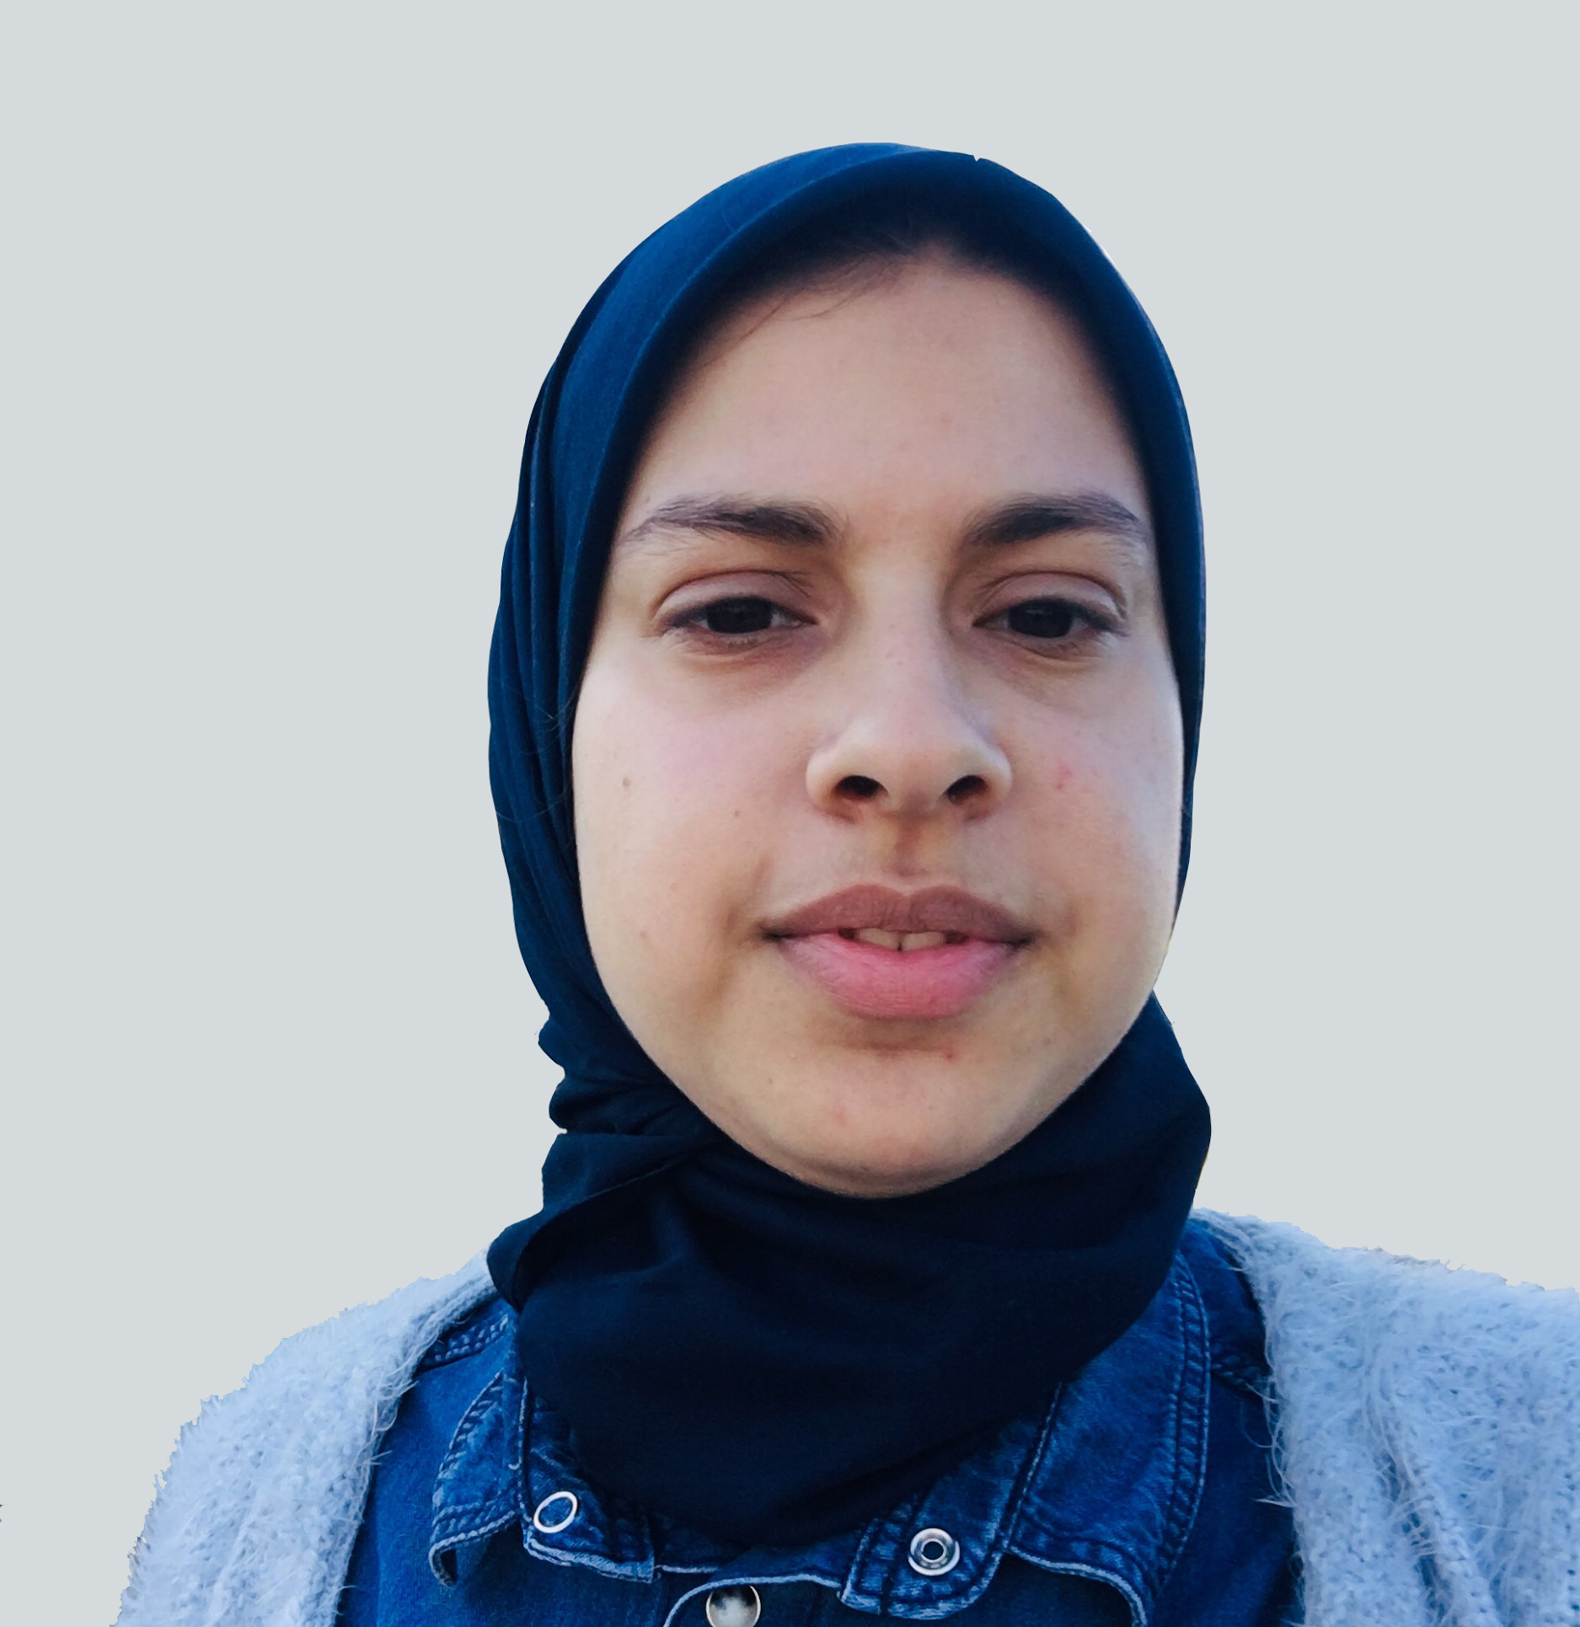

TensorFlow Casablanca
TensorFlow Casablanca Organizer
SARA EL-ATEIF DEEP LEARNING ENGINEER
@el_ateifSara

Slide 2

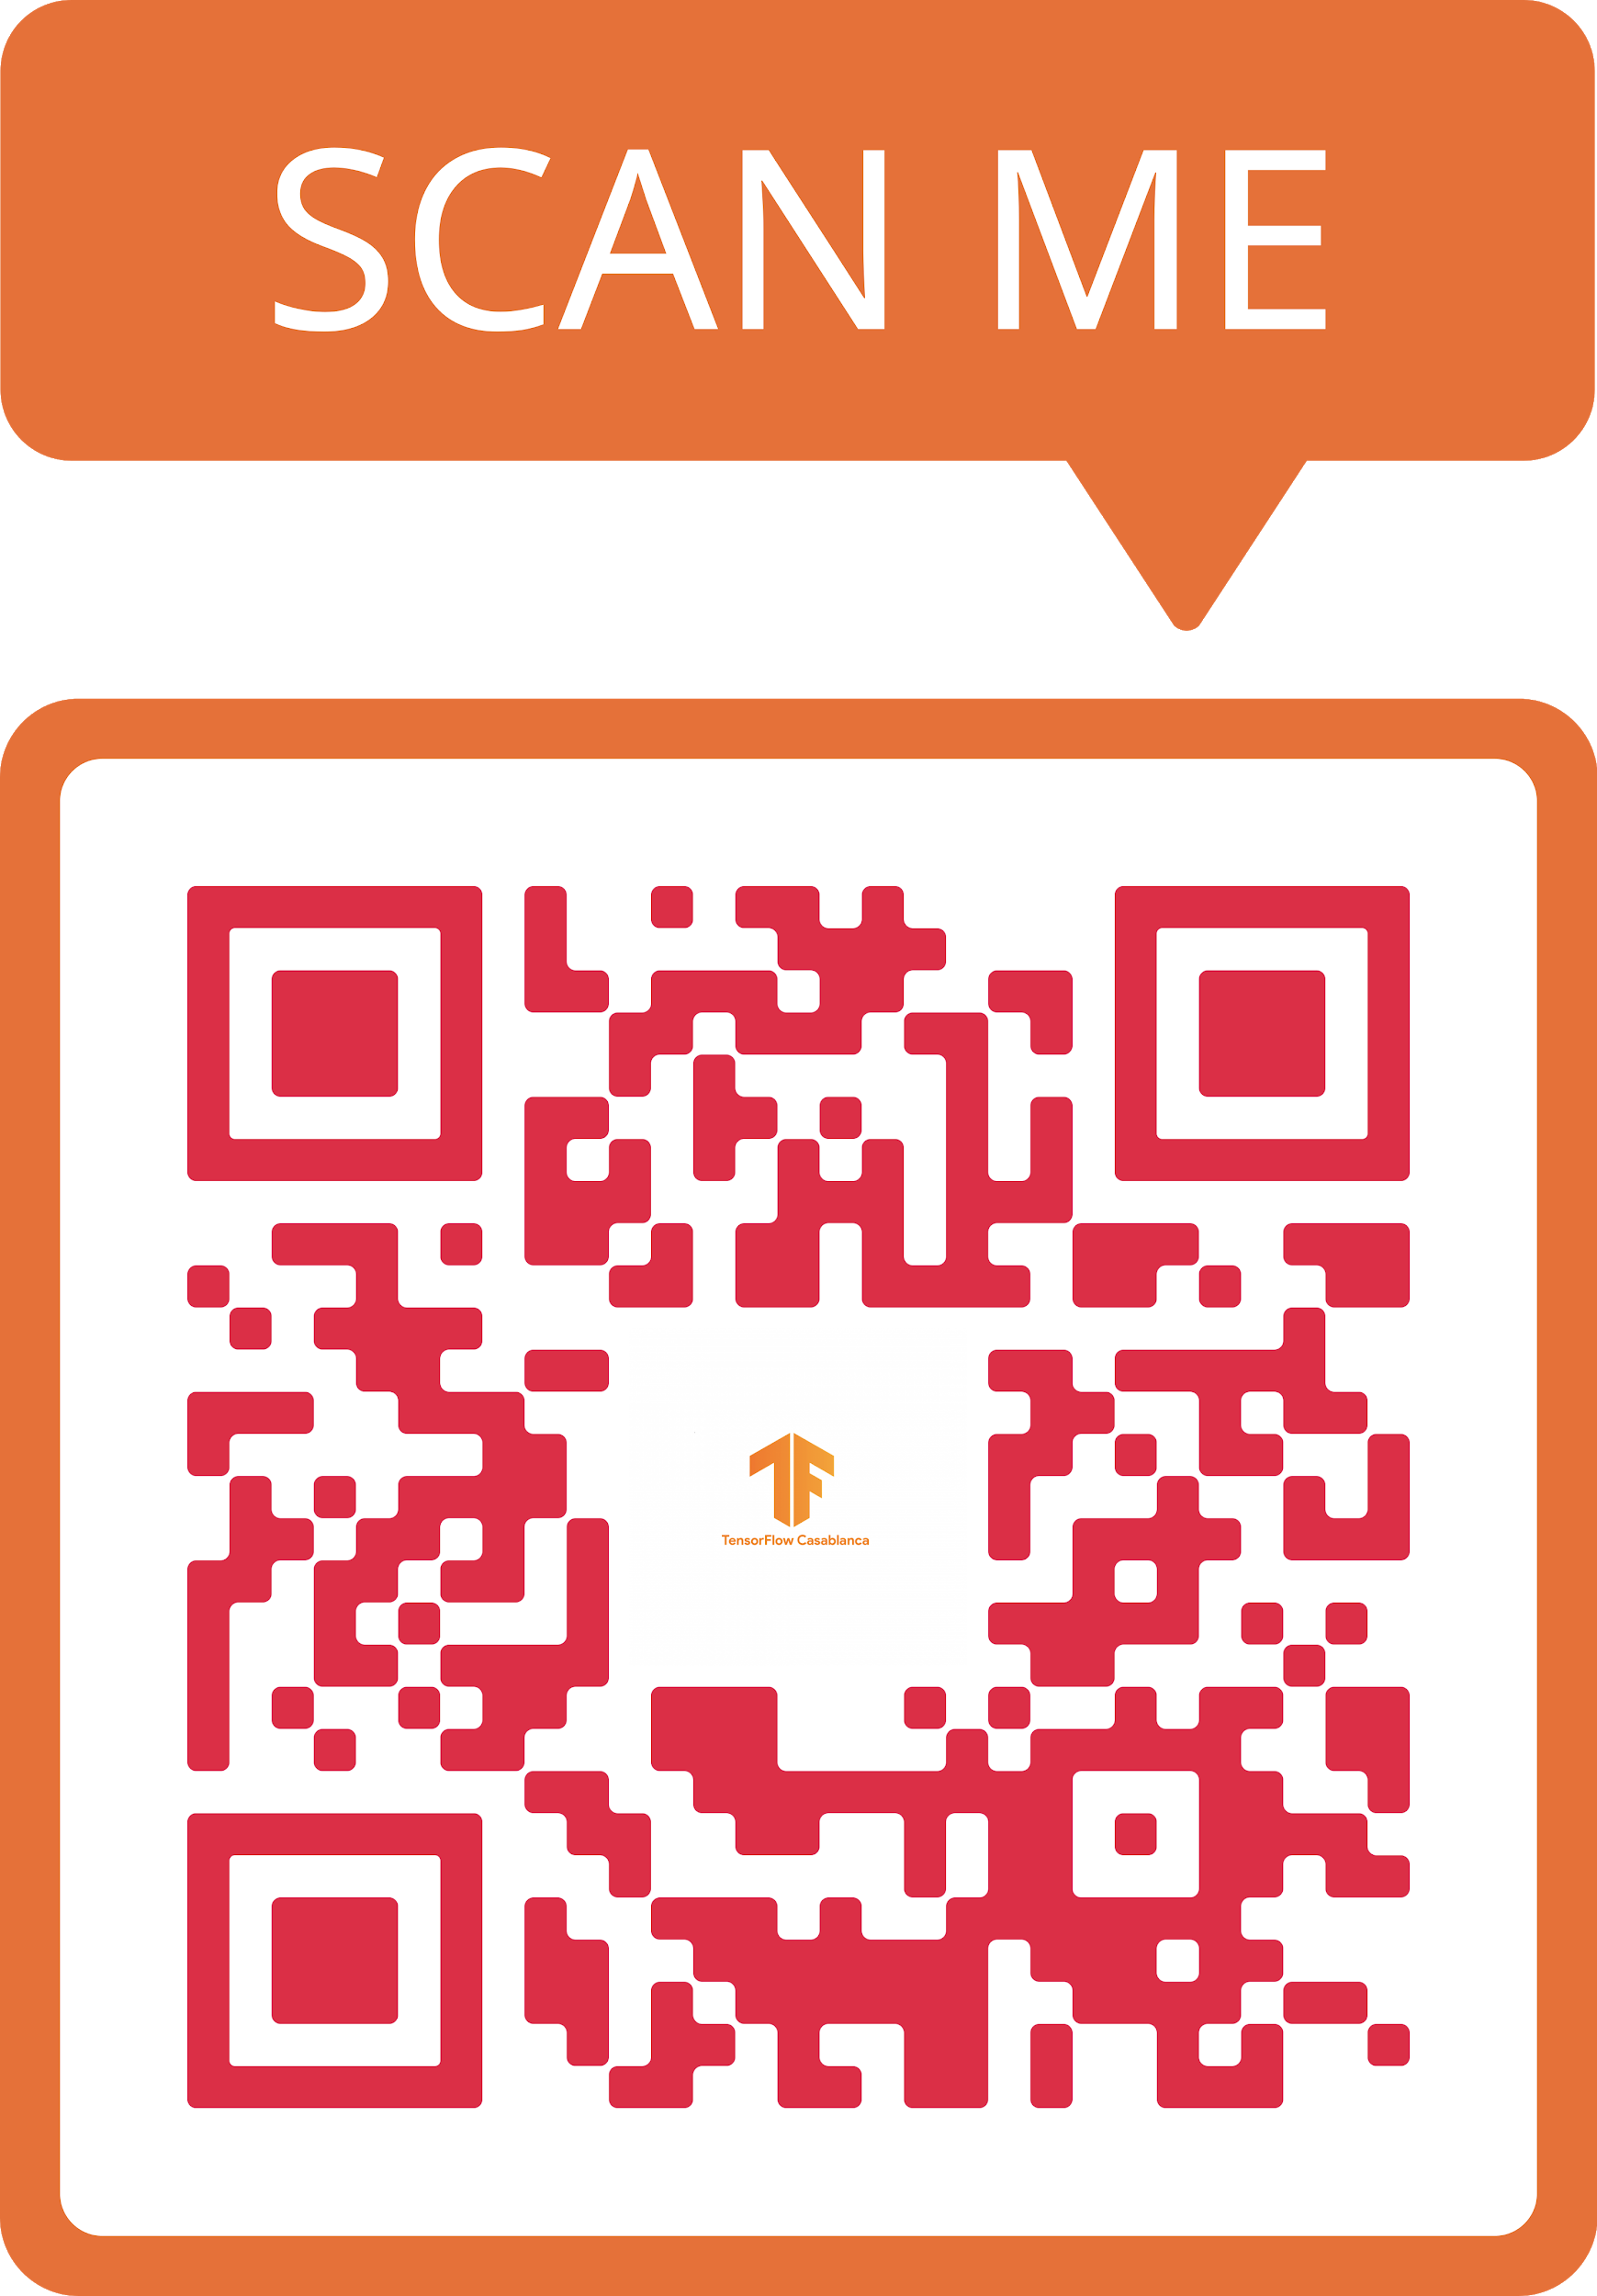

Slide 3
Overview

Slide 4

What is it?
TensorFlow Casablanca is a local community of technologists who are interested in advancing their knowledge of TensorFlow (http://tensorflow.org), its use cases and applications.

Slide 5
Goals
Build projects with TensorFlow
Incorporate models that bring together rigorous academic research and industry R&D
Enable developers to create and deploy their own deep learning models built using TensorFlow
Explore use cases on TensorFlow usage from research to business applications

Slide 6
Who is it for?
If you are interested in TensorFlow and Deep Learning and their applications in real-world problems
If you just want to start with these technologies but you don't know how to join our group.
Help us grow the community, share knowledge, and enjoy a regular dose of human interaction, smiles and conversations on all things TensorFlow.

Slide 7
Upcoming activities
Codelabs
Talks from experts
TF In depth explanation labs

Slide 8
Have a suggestion? Wanna speak at one of our events?
If you're interested in giving a presentation at our group, please contact the organizers or send your talk proposal to our email: tensorflow.casa@gmail.com.
We are always on the lookout for people that want to share their knowledge and experience with other group members.

Slide 9
Code of Conduct
Be nice. We're all part of the same community, so be friendly, welcoming, and generally a nice person. Be someone that other people want to be around.
Be respectful and constructive. Remember to be respectful and constructive with your communication to fellow members. Don't get into flame wars, make personal attacks, vent, or rant unconstructively. Everyone should take responsibility for the community and take the initiative to diffuse tension and stop a negative thread as early as possible.
Be collaborative. Work together! We can learn a lot from each other. Share knowledge, and help each other out.

Slide 10
Code of Conduct
Participate. Join in on discussions, show up for in-person meetings regularly, offer feedback, and help implement that feedback.
Basic etiquette for online discussions. Don’t send messages to a big list that only need to go to one person. Keep off topic conversations to a minimum. Don’t be spammy by advertising or promoting personal projects which are off topic.

Slide 11
Our social media
Twitter: https://bit.ly/tfcasatwitter
Facebook: https://bit.ly/tfCasaFB
MeetUp: https://bit.ly/tfCasaMeetup

Slide 12

🤓 TensorFlow Certification 🧐

Slide 13
🧑‍💻Q&A👩‍💻

Slide 14
Thanks!

